Slide 1


Phonics Workshop
2025

Slide 2
What is “Phonics”?
Phonics is one of the most robust and recognised ways of teaching children to learn to read and write.
It involves teaching children to hear the different sounds (phonemes) that make up words. For example in the word ‘cat’ we can hear 3 sounds…

Slide 3
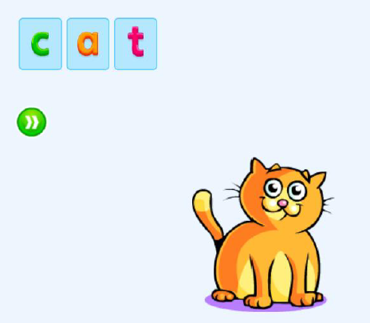
We then teach the children how each of these sounds are represented in print with a letter (grapheme).
C-a-t

Slide 4
So to read…
Children learn to:
Recognise letters and say what sound each one makes
Blend those sounds together to read a word
Say the word and understand what it means

Slide 5


Slide 6
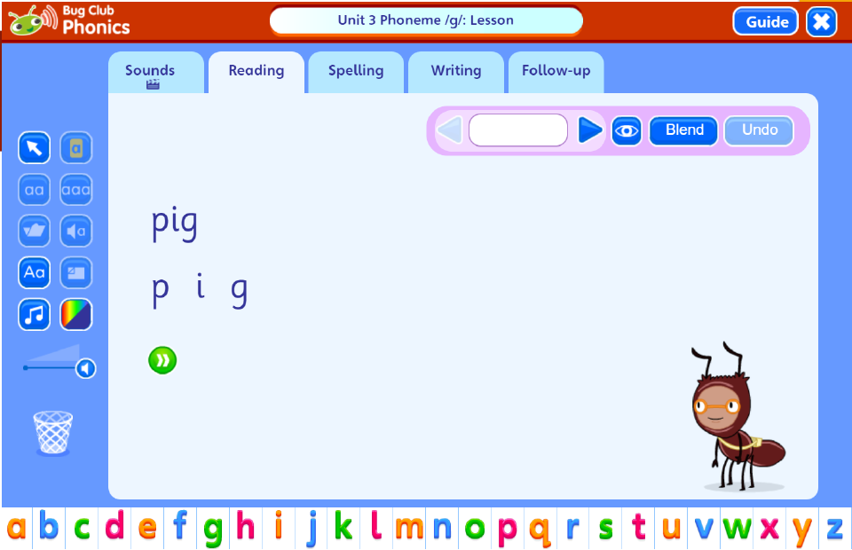

Slide 7
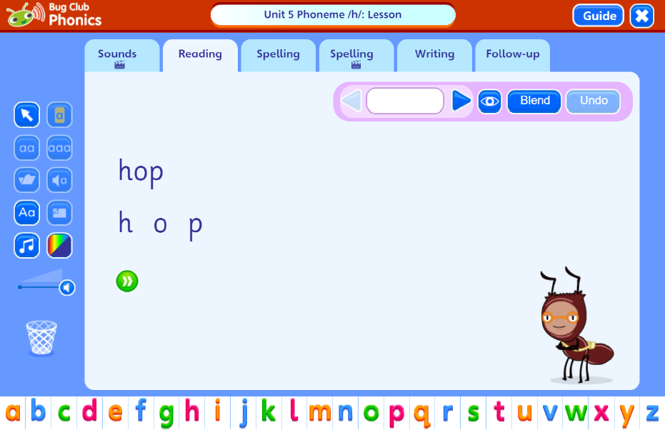

Slide 8


Slide 9
To write…
Writing is the same skill but in reverse.
Say the word
Segment (break up the word) to hear each sound (phoneme)
Choose the right letter (grapheme) to write for each sound they hear

Slide 10
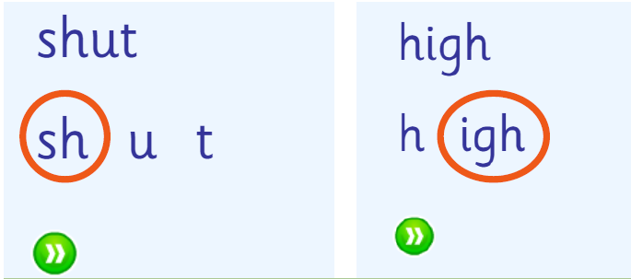
Diagraphs and Trigraphs
Some sounds have more than one letter to represent it.
Sounds with 2 letters are called diagraphs
Sounds with 3 letters are called trigraphs

Slide 11
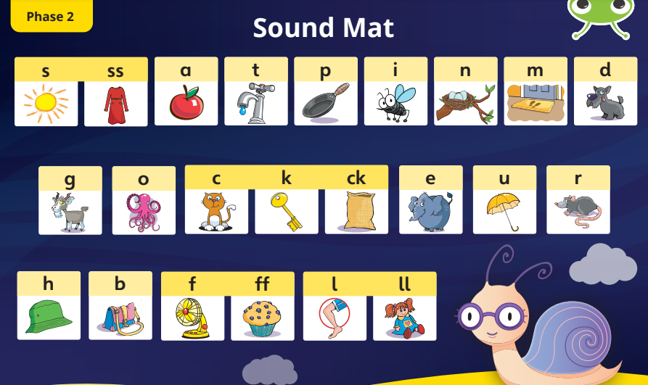
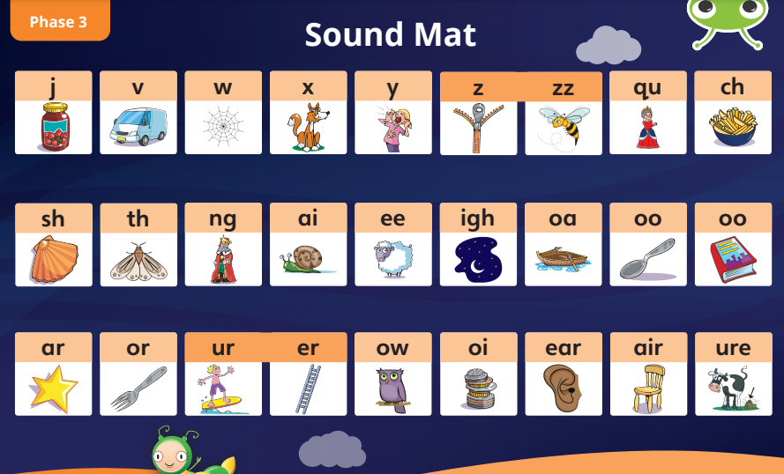
Children spend a busy year in Reception learning one way to read and write each of the 44 sounds in the English language!

Slide 12
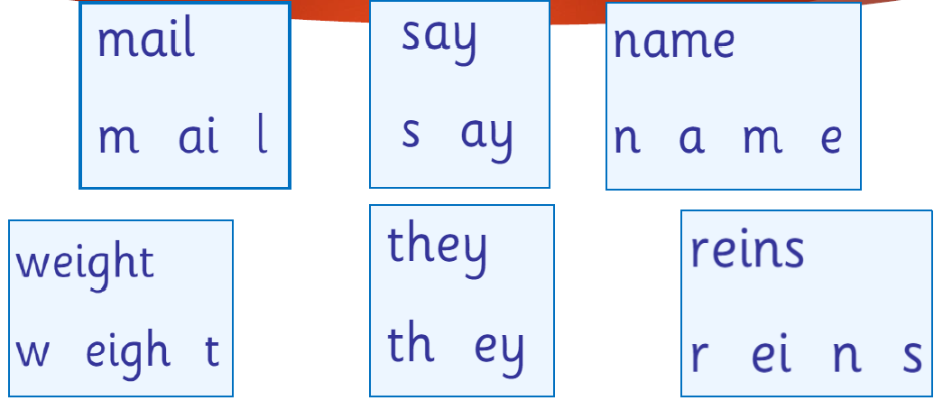
In Year 1, children develop their reading even further by learning there are sometimes different ways to spell the same sound eg.

Slide 13
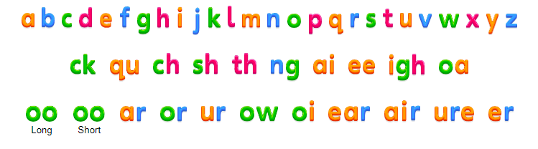
Bug Club sound board

Slide 14
Tricky words!
On top of all of this children are also taught that some words cannot be decoded using the rules they have learnt.
We call these tricky words and the best way children can learn them is by remembering what they look like.

Slide 15
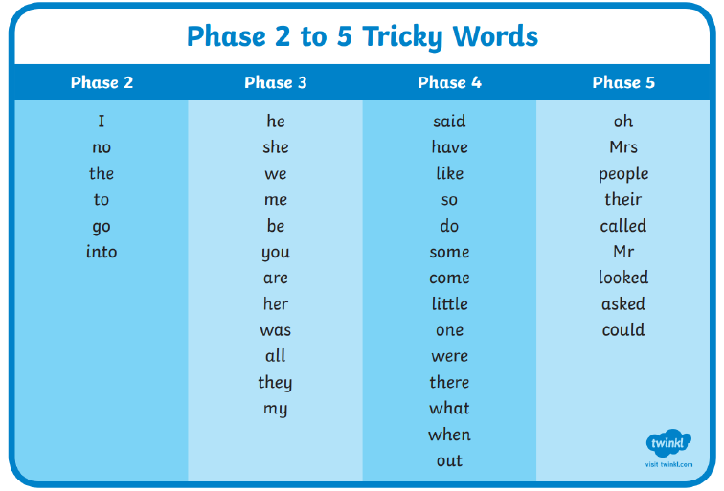

Slide 16
Year 1 Phonics Screening check
Children complete a phonics reading check a the end of Year 1
Summer term – June
A phonics screening check pack will be sent home

Slide 17
The children will be asked to read 40 words
They will complete the test one at a time with a familiar adult
It takes between 2-5 minutes
If they do not manage to read the minimum number of words to pass, they will be given extra support and will repeat the test in Year 2

Slide 18
What to expect in the test?
They will read some words with 2 and 3 sounds eg.
in
dog
ship
play

Slide 19
And then words with different letter combinations like…
Scream
Phone
And longer words like…
Second
Tractor

Slide 20
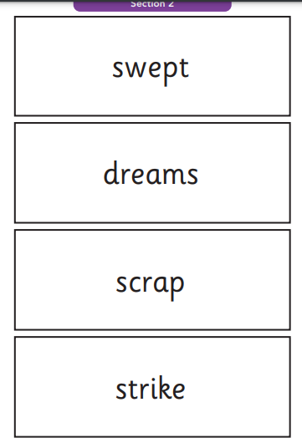
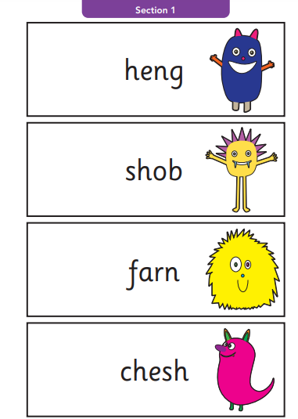
Real words Alien words

Slide 21
How can you help?
Read as much as possible with your child.
“Book related talk introduces children to language that they might not hear in ordinary conversation, especially the vocabulary of the book itself. This primes them to understand what they read later, in their leisure reading and across the curriculum”.

Slide 22

Class library books go home on Fridays for you to enjoy together.

Slide 23

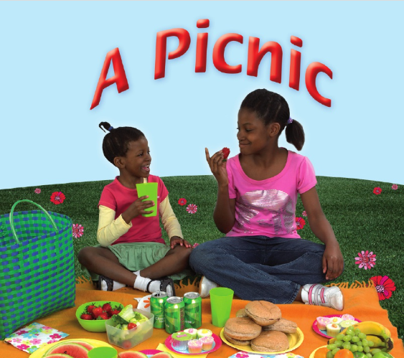
Your child will also bring home a phonics reading book that matches their phonics learning, every day. Please listen to them read it!
Your child also has a log in for Bug Club! They have allocated books and games to play to practise their reading at home.

Slide 24
A final note…
Phonics is not the only thing needed to become a fluent reader
Please continue to read with your child each day (even for 5 minutes) and encourage them to…
Make their reading sound like talking
Re-read it if it doesn’t make sense
Talk about what they read
Most importantly… ENJOY READING!

